Slide 1
REQUIREMENT
BUSINESS CHALLENGES
There is requirement of a repository migration tool which can connect to multiple devops tools available in the market like Azuredevops, GitLab, GitHub Bitbucket, etc.
The tool should be cost-effective and easy to manage.
A project with complex architecture will has its code-base spread across multiple repositories that are part of the different devops tools, and it would be a tedious job to migrate all those repositories to a single devops tool under a single project.
PROPOSED SOLUTION/APPROACH
VALUE ADDITION/BENEFITS
A git-based migration tool is developed, and using a Bash script which accepts the below inputs in the excel file , executes git-based migration in the background and provides the on-screen logs to the user.
Parameter Accepted in the form of excel
Source repository URL with PAT token with a minimum access to read the repository contents
Destination repository URL with PAT token with a minimum access to read & write the repository contents. The destination repository should be empty for the first migration
As of now this tool supports the below migrations workflows
Azuredevops to GitHub and vise-versa
Azuredevops to GitLab and vise-versa
Azuredevops to Bitbucket and vise-versa
It also supports the Tip migration for the repositories.
The tool supports repository migration from most widely used devops tools across the industry
Along with the initial migration it also supports the Tip migration
Execution process is easy to understand
Provides support to migrate multiple repository with details populated in the excel
No hosting required so its cost-effective and can be executed with the free installation of GIT Bash

Slide 2
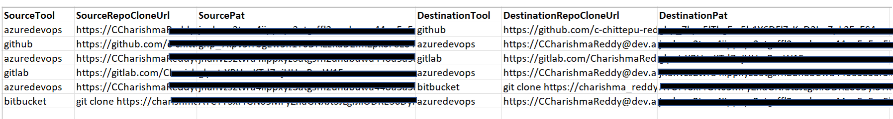
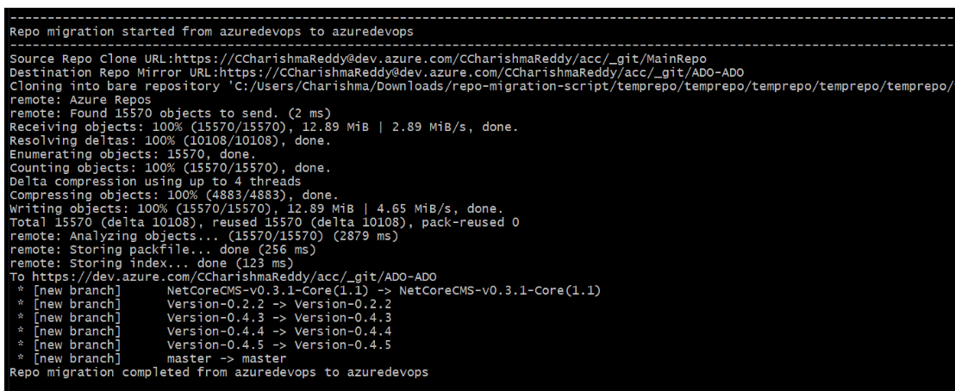
Tool Prerequisites
Codebase available at MigrationSuite - Repos (visualstudio.com)
Prerequisites https://idc-ava-devops-capability.visualstudio.com/_git/MigrationSuite?version=GBmain&path=/ReadMe_BashScript_Details.md&_a=preview#prerequisites
Sample Input Excel
Sample Output On-screen logs for ADO to ADO repository migration

